Slide 1
Data Mining for Business Intelligence
Chapter 3: Data Visualization
Kichun Lee, Ph.D.
Department of Industrial Engineering
Hanyang University, Seoul, Korea

Slide 2
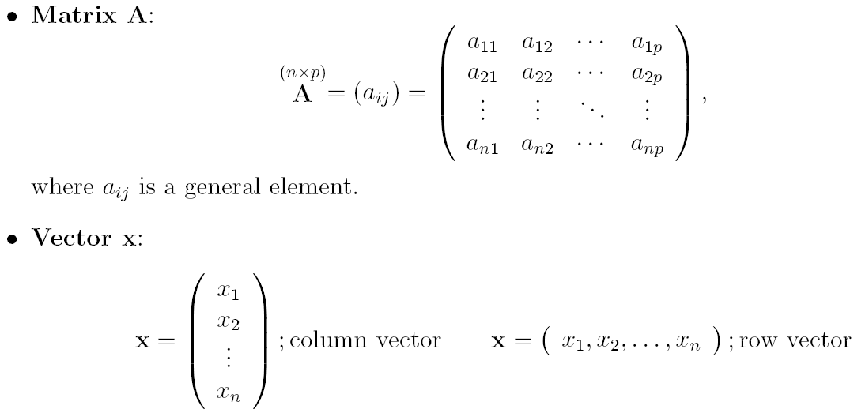
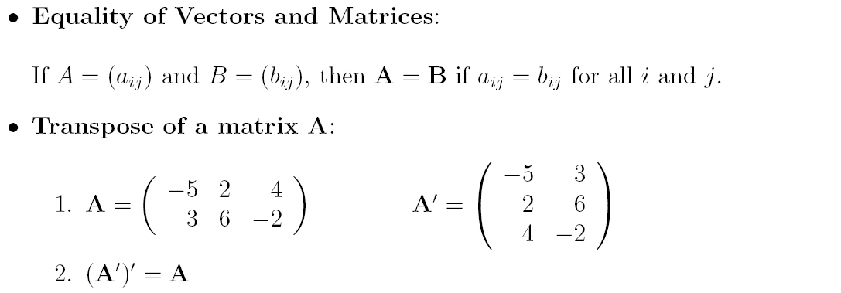
Basic Algebra
<number>/21

Slide 3
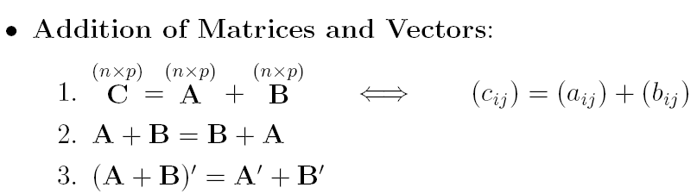
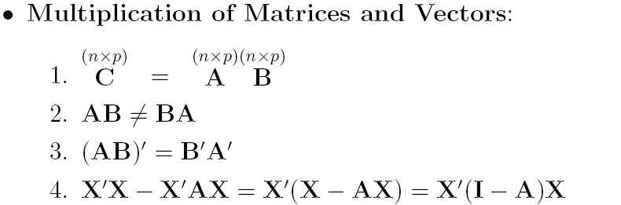
Basic Algebra
(Continued)
(p×p)
<number>/21

Slide 4
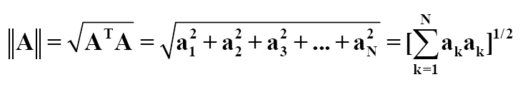

Basic Algebra
(Continued)
벡터의 크기
  원점에서 벡터 공간상의 한 점까지의 거리
단위 벡터
  벡터의 크기가 1인 벡터. 만약, 벡터 v가 0이 아닌 벡터라면 v방향의 단위벡터 u
  벡터 v와 방향이 같은 단위 벡터를 구하는 것을 정규화라고 함
<number>/21

Slide 5
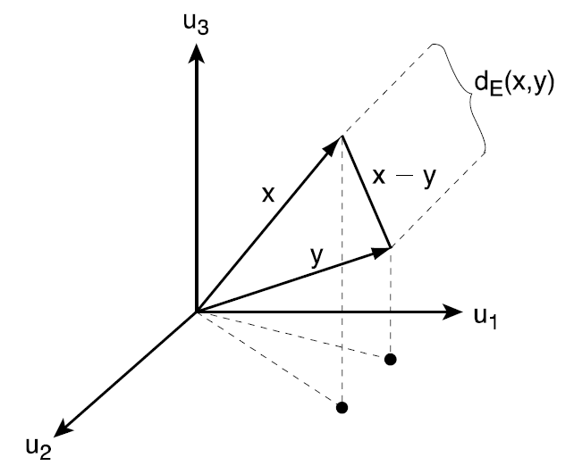
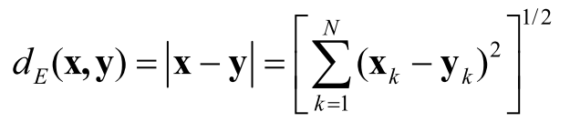
Basic Algebra
(Continued)
    유클리디안 (Euclidean) 거리
      벡터 공간상에서 두 점 간의 거리는 점 사이 벡터 차의 크기로 정의
<number>/21

Slide 6
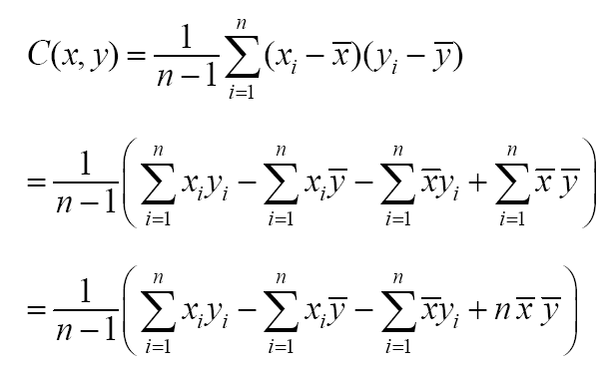
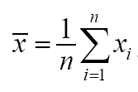
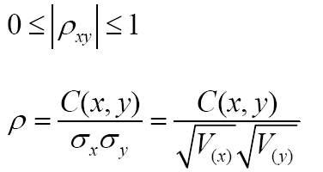
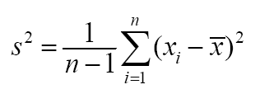
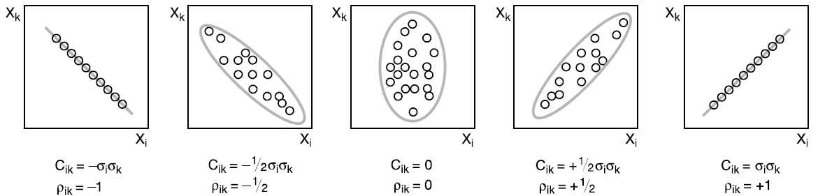
Basic Statistics
Covariance
Correlation
Mean & Variance
<number>/21

Slide 7
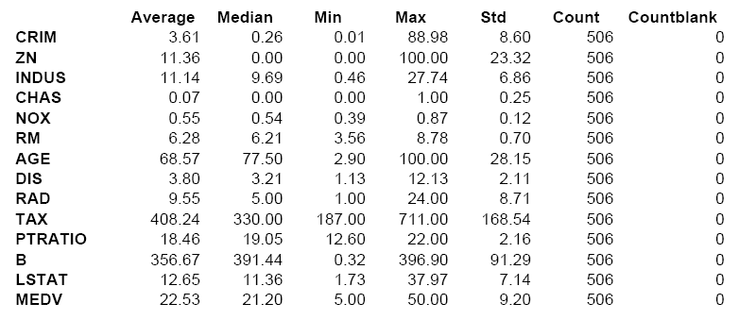
Boston Housing: Summary Statistics
<number>/21

Slide 8
Graphs for Data Exploration
Basic Plots
  Line Graphs
  Bar Charts
  Scatterplots
Distribution Plots
  Boxplots
  Histograms
<number>/21

Slide 9
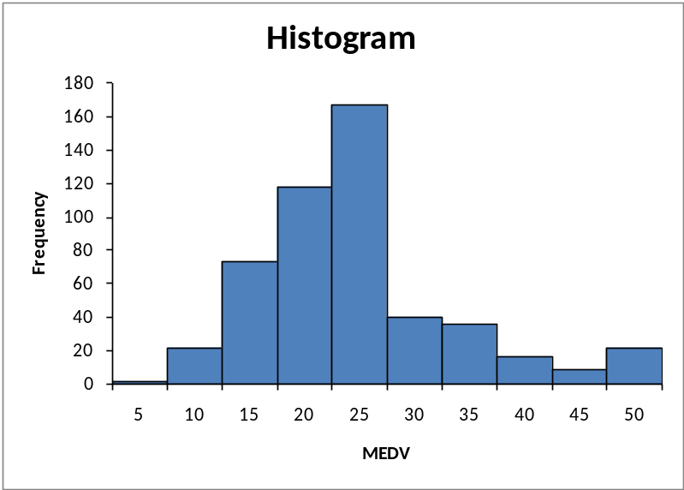
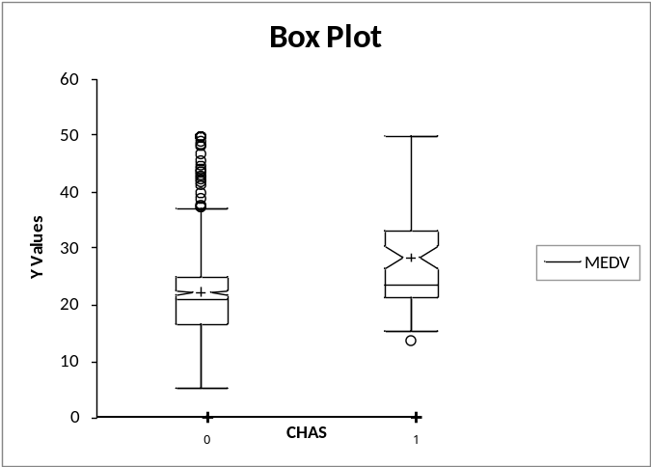
Boston Housing: Visualization
Display “how many” of each value occur in a data set
Or, for continuous data or data with many possible values, “how many” values are in each of a series of ranges or “bins”
<number>/21

Slide 10
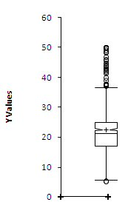
Box Plot
Top outliers defined as those above Q3+1.5(Q3-Q1).
“max” is the maximum of non-outliers
Analogous definitions for bottom outliers and for “min”
Details may differ across software
outliers
“max”
Quartile 3
mean
Median
Quartile 1
“min”
outlier
<number>/21

Slide 11
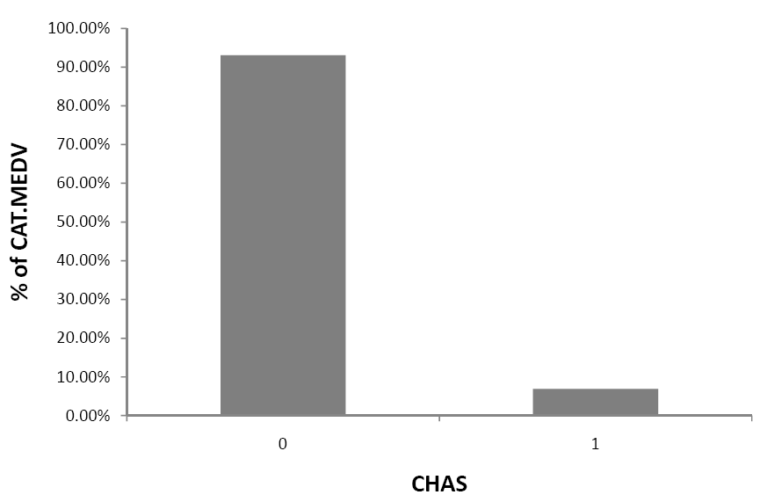
Bar Chart for Categorical Variable
95% of tracts do not border Charles River

Slide 12
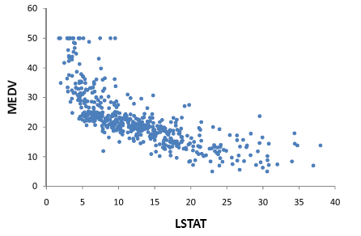
Scatterplot
Displays relationship between two numerical variables

Slide 13
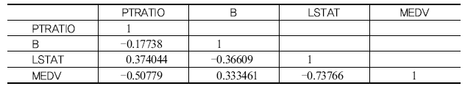
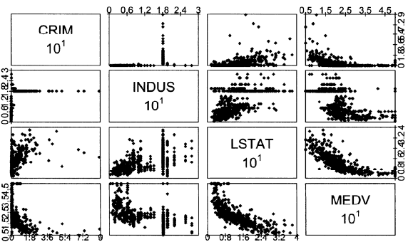
Boston Housing: Correlation Analysis
Matrix plot:
Shows scatterplots for variable pairs
<number>/21

Slide 14
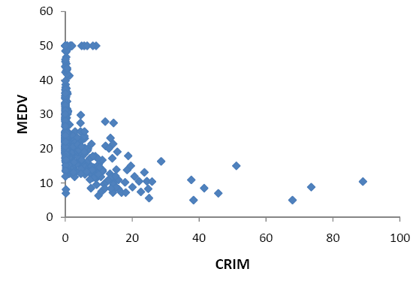
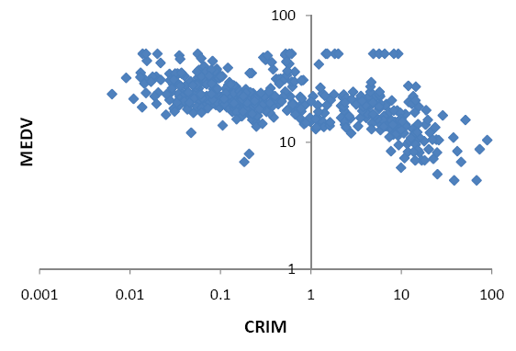
Rescaling to log scale (on right)
“uncrowds” the data

Slide 15
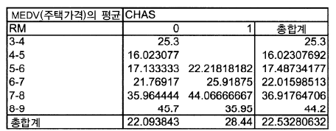
Boston Housing: Pivot Tables
Group by multiple criteria:
E.g., neighborhoods on the Charles with 6-7 rooms have average house value of 25.92 ($000)
<number>/21

Slide 16
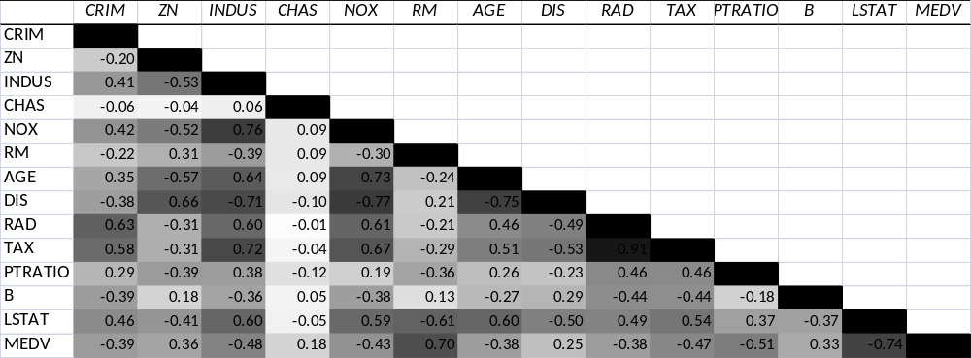
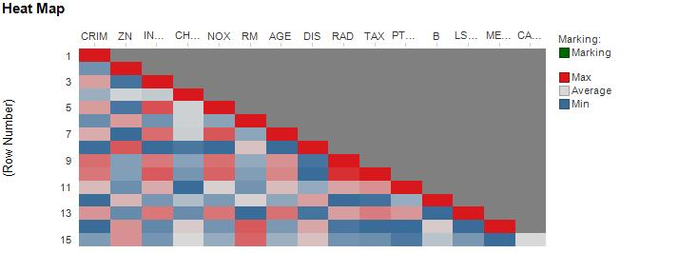
Heatmap to highlight correlations
(Boston Housing)
In Excel (using conditional formatting)
In Spotfire

Slide 17
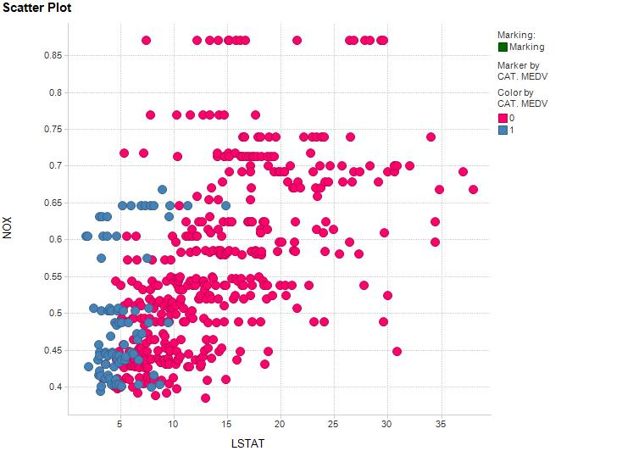
Scatterplot with color added
Boston Housing
NOX vs. LSTAT
Red = low median value
Blue = high median value

Slide 18
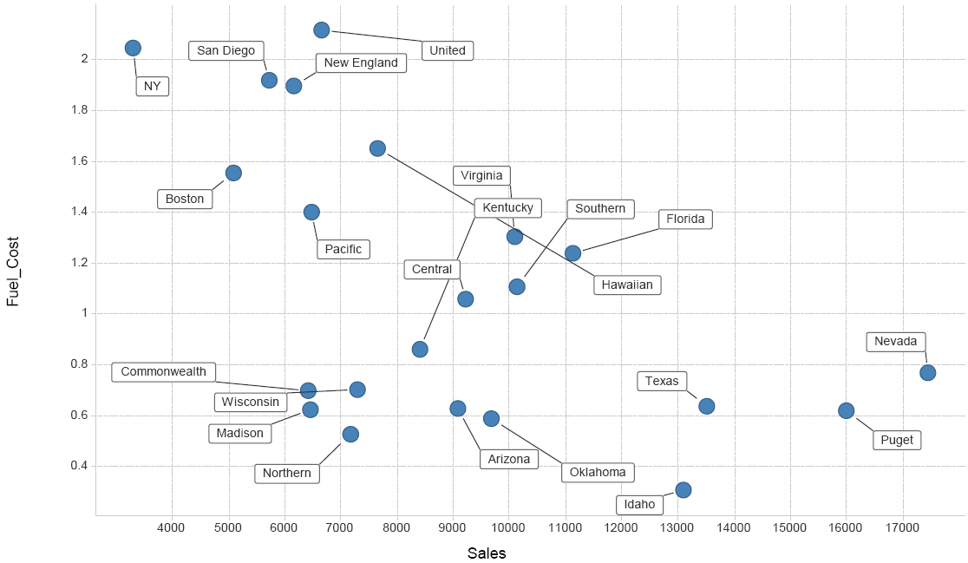
Scatter Plot with Labels (Utilities)

Slide 19
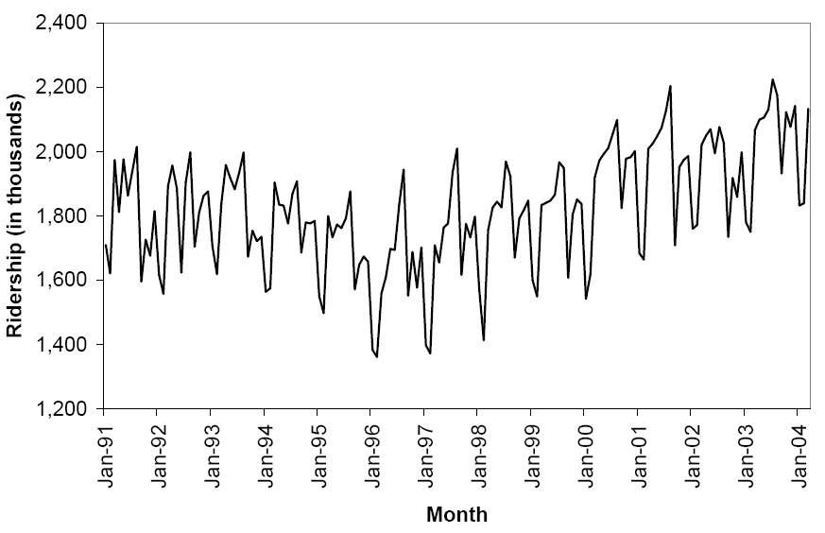
Line Graph for Time Series

Slide 20
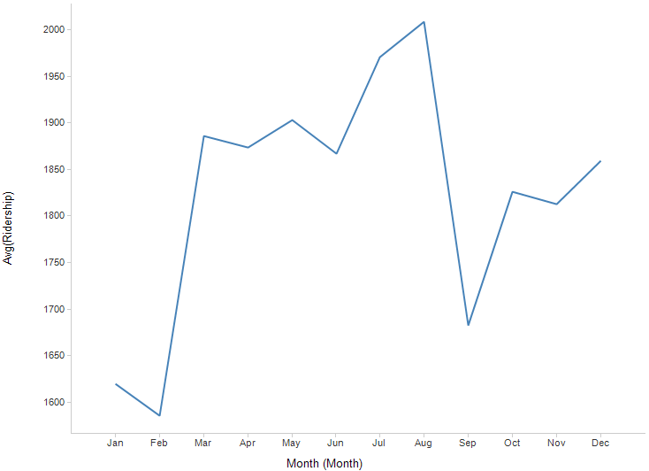
Aggregation – Monthly Average

Slide 21
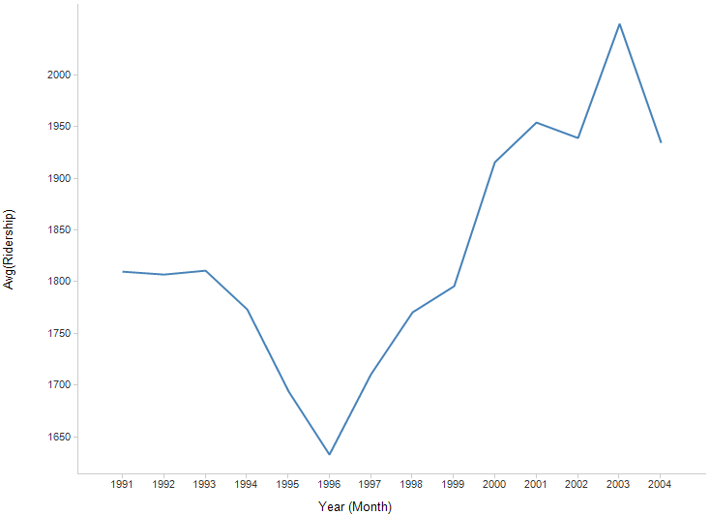
Aggregation – Yearly Average

Slide 22
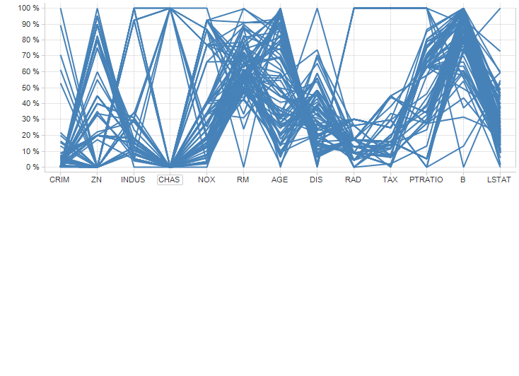
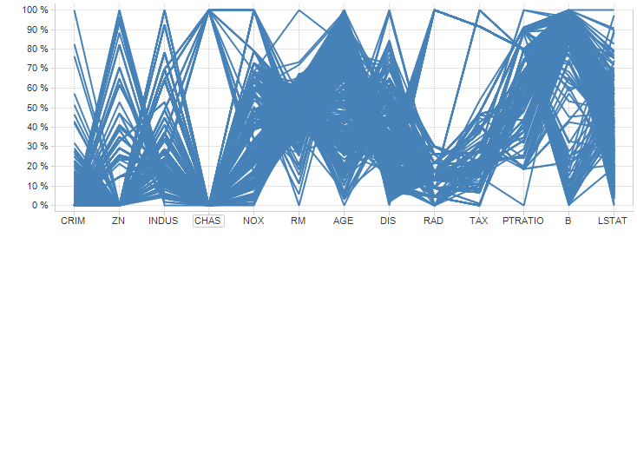
Parallel Coordinate Plot (Boston Housing)
CATMEDV =1
CATMEDV =0
Filter Settings
- CAT. MEDV: (1)

Slide 23
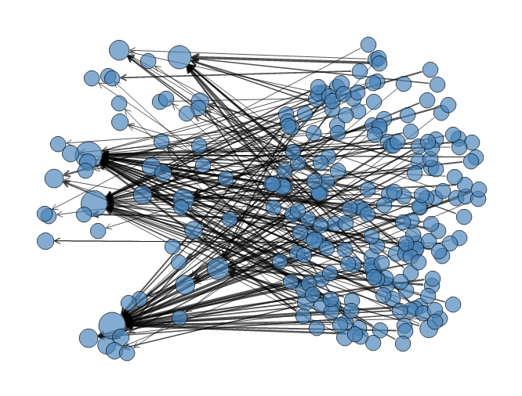
Network Graph – eBay Auctions
(sellers on left, buyers on right)
Circle size = # of transactions for the node
Line width =# of auctions for the buyer-seller pair
Arrows point from buyer to seller

Slide 24
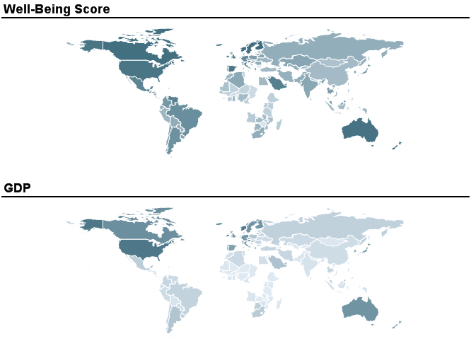
Map Chart
(Comparing countries’ well-being with GDP)
Darker = higher value

